Slide 1
Module4 Introduction to ASSET-ABCKED SECURITIES
Mortgage pass-through securities
The bonds created from the securitization of mortgages related to the purchase of residential properties are residential mortgage-backed securities (RMBS).
In the United States, securities backed by residential mortgages are divided into three sectors: (1) those guaranteed by a federal agency, (2) those guaranteed by a GSE, and (3) those issued by private entities and that are not guaranteed by a federal agency or a GSE. The first two sectors are referred to as agency RMBS, and the third sector is referred to as non-agency RMBS.

Slide 2
Module4 Introduction to ASSET-ABCKED SECURITIES
Mortgage pass-through securities
Agency RMBS issued by GSEs differ from non-agency RMBS in two ways.
The credit risk of the RMBS issued by Fannie Mae and Freddie Mac is reduced by the guarantee of the GSE itself. Non-agency RMBS use credit enhancements to reduce credit risk.
Loans satisfying the underwriting standards for inclusion as collateral for an agency RMBS are called “conforming” mortgages; otherwise, loans are categorized as “non-conforming” mortgages.

Slide 3
Module4 Introduction to ASSET-ABCKED SECURITIES
Characteristics
The monthly cash flows of a mortgage pass-through security are less than the monthly cash flows of the underlying pool of mortgages by an amount equal to the servicing and other administrative fees.
A mortgage pass-through security’s coupon rate is called the pass-through rate. The pass-through rate that the investor receives is said to be “net interest” or “net coupon.”
Not all mortgages included in a pool of securitized mortgages have the same mortgage rate and the same maturity. Consequently, for each mortgage pass-through security, a weighted average coupon rate (WAC) and a weighted average maturity (WAM) are determined. The

Slide 4
Module4 Introduction to ASSET-ABCKED SECURITIES
Weighted average coupon rate and weighted average maturity
Mortgage | Outstanding mortgage balance | Coupon rate(%) | Number of months to maturity
1 | 1,000 | 5.1 | 34
2 | 3,000 | 5.7 | 76
3 | 6,000 | 5.3 | 88

Slide 5
Module4 Introduction to ASSET-ABCKED SECURITIES
Prepayment risk
Contraction risk is the risk that when interest rates decline, actual prepayments will be higher than forecasted because homeowners will refinance at now-available lower interest rates.
First, investors must reinvest the proceeds at lower interest rates. Second, if the security is prepayable or callable, its price appreciation is not as great as that of an otherwise identical bond without a prepayment or call option.
In contrast, extension risk is the risk that when interest rates rise, prepayments will be lower than forecasted because homeowners are reluctant to give up the benefits of a contractual interest rate that now looks low.

Slide 6
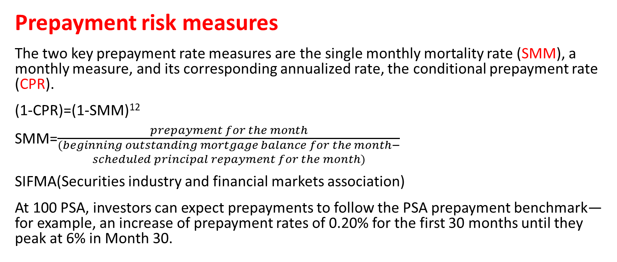
Module4 Introduction to ASSET-ABCKED SECURITIES
Prepayment risk measures
The two key prepayment rate measures are the single monthly mortality rate (SMM), a monthly measure, and its corresponding annualized rate, the conditional prepayment rate (CPR).
(1-CPR)=(1-SMM)¹²
SMM=$\frac{prepayment for the month}{\begin{aligned}(beginning outstanding mortgage balance for the month− \\ scheduled principal repayment for the month)\end{aligned}}$
SIFMA(Securities industry and financial markets association)
At 100 PSA, investors can expect prepayments to follow the PSA prepayment benchmark—for example, an increase of prepayment rates of 0.20% for the first 30 months until they peak at 6% in Month 30.

Slide 7
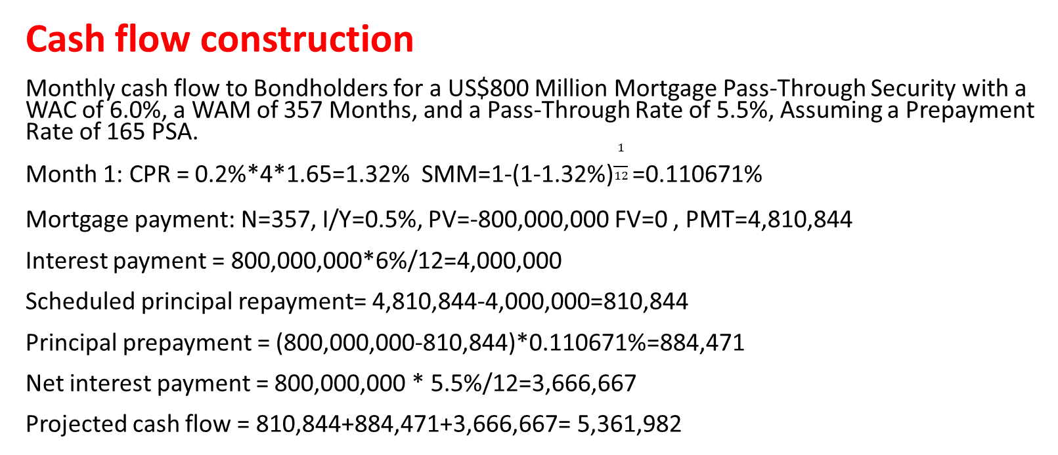
Module4 Introduction to ASSET-ABCKED SECURITIES
Cash flow construction
Monthly cash flow to Bondholders for a US$800 Million Mortgage Pass-Through Security with a WAC of 6.0%, a WAM of 357 Months, and a Pass-Through Rate of 5.5%, Assuming a Prepayment Rate of 165 PSA.
Month 1: CPR = 0.2%*4*1.65=1.32% SMM=1-(1-1.32%)$\frac{1}{12}$=0.110671%
Mortgage payment: N=357, I/Y=0.5%, PV=-800,000,000 FV=0 , PMT=4,810,844
Interest payment = 800,000,000*6%/12=4,000,000
Scheduled principal repayment= 4,810,844-4,000,000=810,844
Principal prepayment = (800,000,000-810,844)*0.110671%=884,471
Net interest payment = 800,000,000 * 5.5%/12=3,666,667
Projected cash flow = 810,844+884,471+3,666,667= 5,361,982

Slide 8
Module4 Introduction to ASSET-ABCKED SECURITIES
Cash flow construction
Month | Beginning outstanding mortgage balance ① | SMM(%) ② | Mortgage payment ③ | Interest payment ④=①*6%/12 | Scheduled principal repayment ⑤=③-④ | Principal prepayment ⑥=(①-⑤)*② | Net interest payment ⑦=①*5.5%/12 | Projected cash flow ⑧=⑤+⑥+⑦ | Ending outstanding mortgage balance ⑨=①-⑤-⑥
1 | 800,000,000 | 0.111 | 4,810,844 | 4,000,000 | 810,844 | 884,472 | 3,666,667 | 5,361,982 | 798,304,684
2 | 798,304,684 | 0.139 | 4,805,520 | 3,991,523 | 813,997 | 1,104,931 | 3,658,896 | 5,577,823 | 796,385,757
…
357 | 240,980 | 0.865 | 242,185 | 1,205 | 240,980 | 0 | 1,104 | 242,084 | 0

Slide 9
Module4 Introduction to ASSET-ABCKED SECURITIES
Weighted average life
The average life extends when the prepayment rate goes down and contracts rapidly as the prepayment rate goes up.
ESG risk for RMBS
Natural disaster risk
Covid-19 pandemic

Slide 10
Practices
1. A non-conforming mortgage:
cannot be used as collateral in a mortgage-backed security.
does not satisfy the underwriting standards for inclusion as collateral for an agency residential mortgage-backed security.
does not give the lender a claim against the borrower for the shortfall between the amount of the outstanding mortgage balance and the proceeds from the sale of the property if the borrower defaults on the mortgage.
2. The monthly cash flows of a mortgage pass-through security most likely:
are constant.
change when interest rates decline.
are equal to the cash flows of the underlying pool of mortgages.

Slide 11
practices
3. A prepayment rate of 80 PSA means that investors can expect:
80% of the par value of the mortgage pass-through security to be repaid prior to the security’s maturity.
80% of the borrowers whose mortgages are included in the collateral backing the mortgage pass-through security to prepay their mortgages.
the prepayment rate of the mortgages included in the collateral backing the mortgage pass-through security to be 80% of the monthly prepayment rates forecasted by the PSA model.
4. All else being equal, when interest rates decline:
investors in mortgage pass-through securities face extension risk.
the weighted average maturity of a mortgage pass-through security lengthens.
the increase in the price of a mortgage pass-through security is less than the increase in the price of an otherwise identical bond with no prepayment option.

